Slide 1

Retrospective on multibody Dynamics and challenge problems
Prof. Jeff Trinkle
Director, CS Robotics Laboratory
Department of Computer Science
Rensselaer Polytechnic Institute
Troy NY, 12180 USA

Slide 2
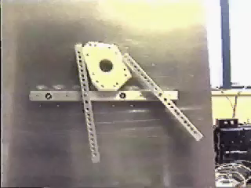
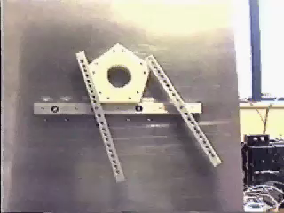
Quasi-Static Manipulation Planning
Valid quasi-static plan exists
No quasi-static plan found
Dynamic plan exists
+ Trinkle, Abel, Paul. An Investigation of Frictionless Enveloping Grasping in the Plane. IJRR, 1988.
+ Trinkle, Hunter. A Framework for Planning Dexterous Manipulation. ICRA, 1991.
+ Trinkle, Ram, Farahat, Stiller. Dexterous Manipulation Planning and Execution of an Enveloped Slippery Workpiece. ICRA, 1993.
+ Trinkle, Farahat, Stiller. First-Order Stability Cells of Active Multi-Rigid-Body Systems. Trans on Robotics and Automation, 1995.
+ Pang, Trinkle, Lo. A Complementarity Approach to a Quasistatic Rigid Body Motion Problem. Journal of Computational Optimization and Applications, 1996
+ Stewart, Trinkle. An Implicit Time-Stepping Scheme for Rigid Body Dynamics with Inelastic Collisions and Coulomb Friction. International Journal of Numerical Methods in Engineering, 1996.
+ Trinkle, Pang, Sudarsky, Lo. On Dynamic Multi-Rigid-Body Contact Problems with Coulomb Friction. Zeitschrift fur Angewandte Mathematik und Mechanik, 1997.

Slide 3
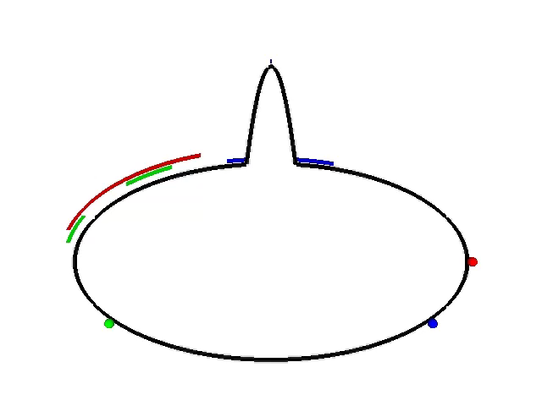
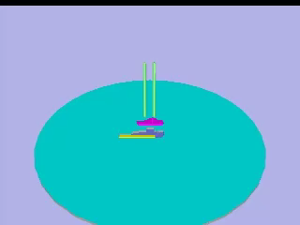

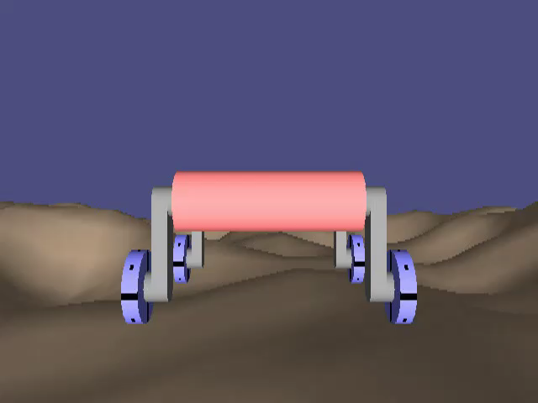
Dynamic Manipulation
Simulation theory and implementation
Simulation-based design for assembly
+ Stewart, Trinkle. An Implicit Time-Stepping Scheme for Rigid Body Dynamics with Inelastic Collisions and Coulomb Friction. International Journal of Numerical Methods in Engineering, 1996.
+ Trinkle, Pang, Sudarsky, Lo. On Dynamic Multi-Rigid-Body Contact Problems with Coulomb Friction. Zeitschrift fur Angewandte Mathematik und Mechanik, 1997.
+ Nguyen, Trinkle. dVC3d: A Three- Dimensional Physical Simulation Tool for Rigid Bodies with Intermittent Contact and Coulomb Friction. First Joint International Conference on Multibody System Dynamics, 2010.
+ Balkcom, Trinkle. Computing Wrench Cones for Planar Rigid Body Contact Tasks. IJRR, 2002.
http://umbra.sandia.gov/

Slide 4
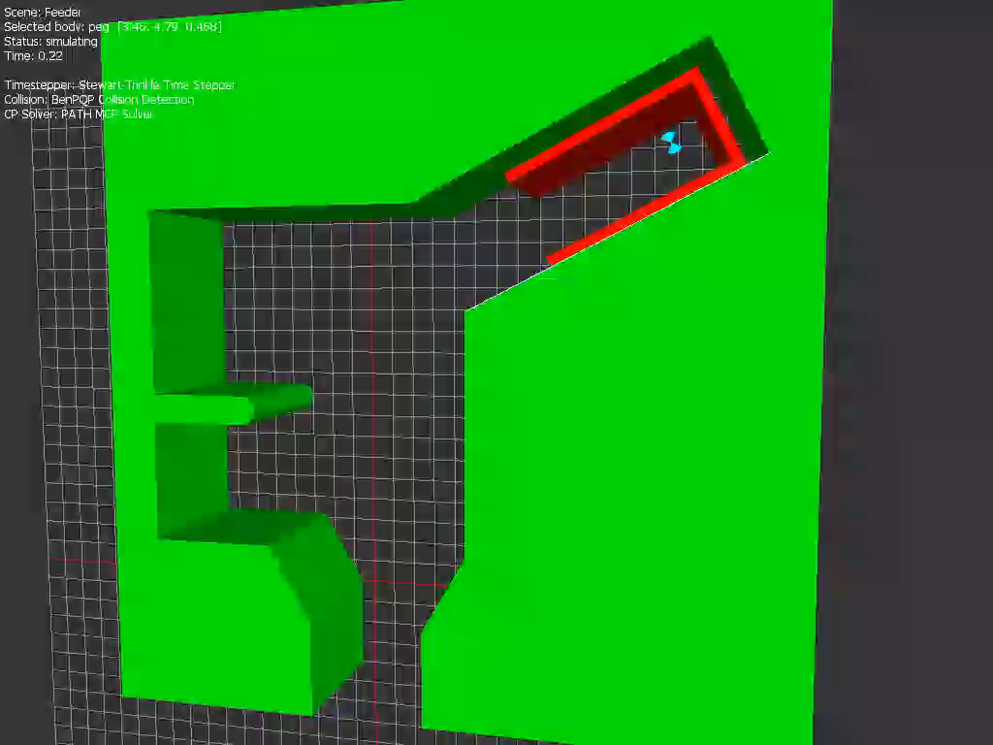
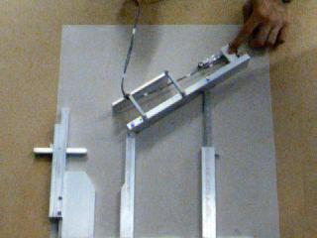
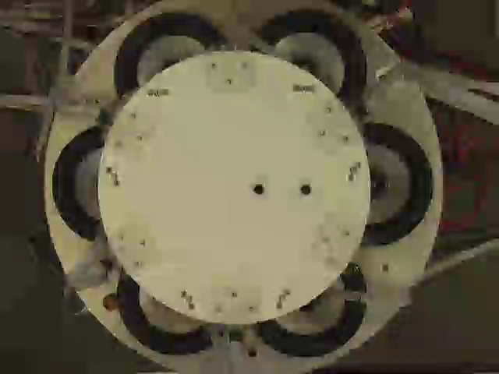
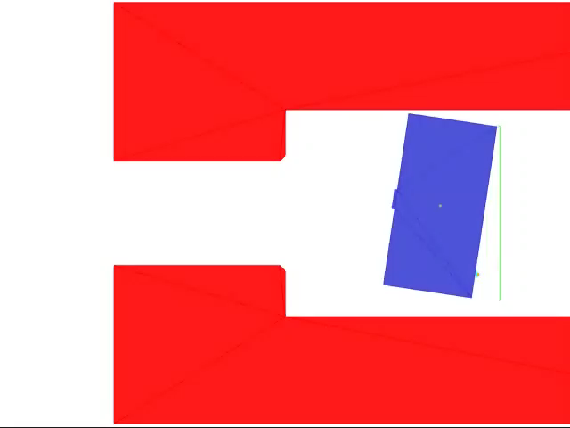
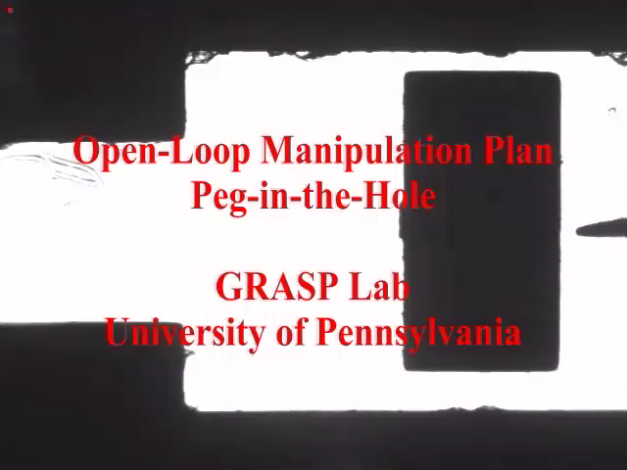
Dynamic Manipulation
Simulation-based design for parts feeding
+ Song, Trinkle, Kumar, Pang. Design of Part Feeding and Assembly Processes with Dynamics. ICRA 2004. Best Automation Paper.
+ Berard, Nguyen, Anderson, Trinkle. Sources of Error in a Rigid Body Simulation of Rigid Parts on a Vibrating Rigid Plate. ASME Journal of Computational and Nonlinear Dynamics. 2010.
Simulation-based design for meso-scale assembly
+ Cappelleri, Fink, Munkundakrisnam, Kumar, Trinkle. Designing open loop plans for planar micro-manipulation. ICRA. 2006.

Slide 5
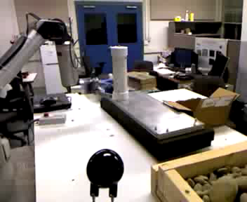
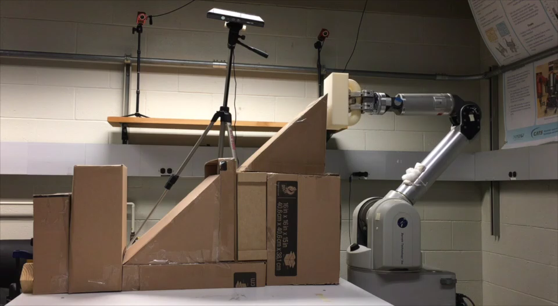
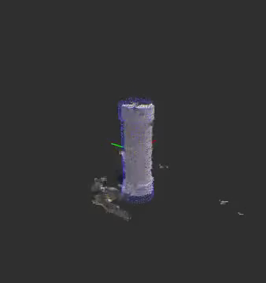
MDB in Perception and Learning
+ Zhang, Trinkle. Exploring the Application of Particle Filters to Grasping Acquisition with Visual Occlusion and Tactile Sensing. ICRA, 2012.
+ Zhang, Lyu, Trinkle. A Dynamic Bayesian Approach to Real-Time Estimation and Filtering in Grasp Acquisition. ICRA, 2013.
+ Li, Lyu, Trinkle. State Estimation for Dynamic Systems with Intermittent Contact, ICRA, 2015.
+ Li, Lyu, Trinkle. Q-Learning of Complex Manipulation Tasks, ICRA, 2017, submitted.
Notes:
In the video, the WAM in our lab tries to grasp a cylinder, but instead knocks it over. The goal of our project is to develop filters that can estimate the state of the object, points of contact, and important model parameters, in order to improve the reliability of grasp acquisition and other manipulation tasks. The key features of our approach are the formulation of the problem as a dynamic Bayesian network, which incorporates an accurate model of dynamics with contact formulated as a complementarity problem.

Slide 6
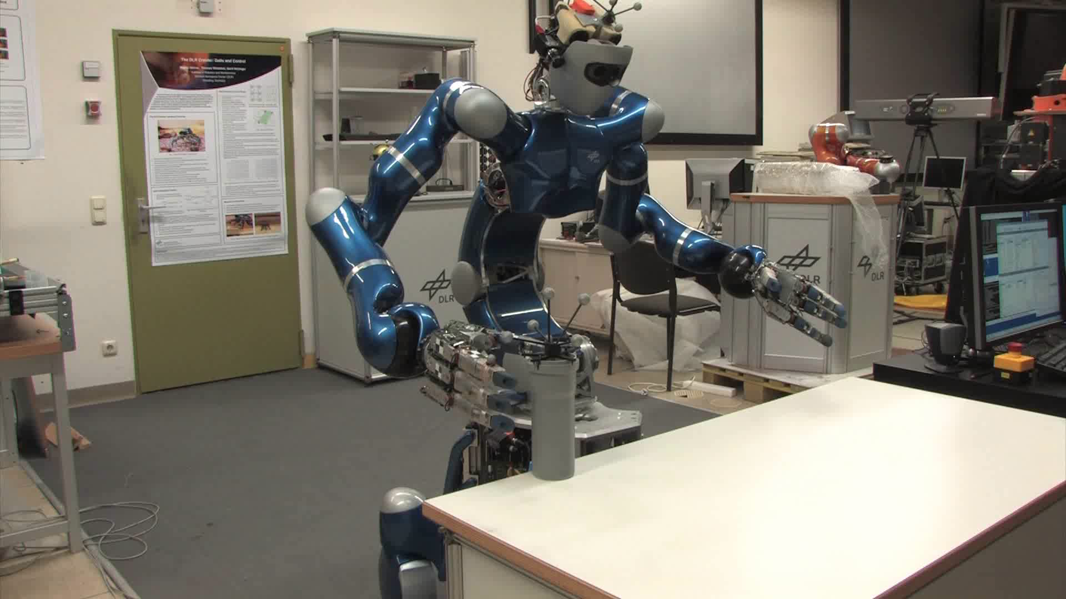
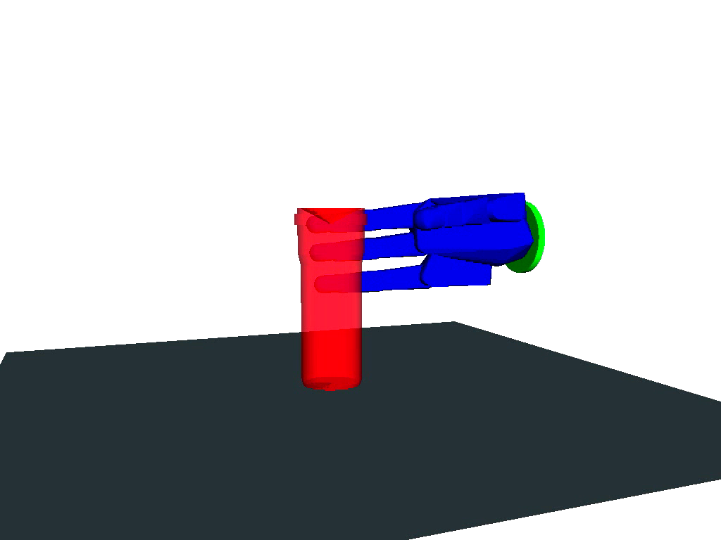
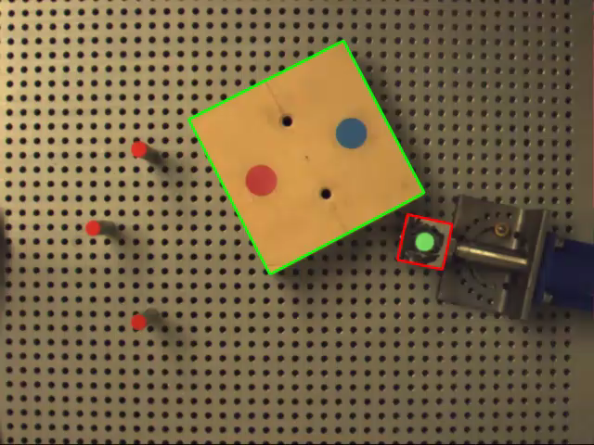
Challenges in MBD Simulation
Which model formulation?
Rigid or compliant contacts
Linearize or not
Convexify or not
Regularize or not
First-order or higher
Benchmarking and fair comparisons
HDF5 database of benchmark problems: https://grasp.robotics.cs.rpi.edu/bpmd/
Simpack. Compliant
Contacts and 100s
Of parameters to tune
+ Lu. A Framework For Comparison of Methods For Solving Complementarity Problems That Arise In Multibody Dynamics, Phd Thesis, CS Dept, RPI, 2016.
+ Lu, Trinkle. Comparison of Multibody Dynamics Solver Performance: Synthetic Versus Realistic Data, ASME IDETC, 2015.

Slide 7
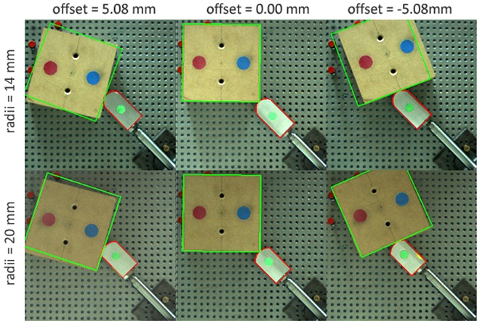
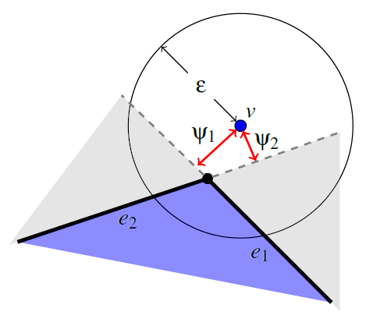
More Challenges
Model Validation
Domain of applicability
Model predictive control
+ Zhang, Betz, Trinkle. Comparison of Simulated and Experimental Grasping Actions in the Plane. First Joint Int’l Conf. on Multibody System Dynamics, 2010.
Zeroeth-order geometric errors
Penetration correction
Non-physical variations of contact information
+A Geometrically Exact Contact Model for Polytopes in Multirigid-Body Simulation. Williams, Lu, Trinkle, Journal of Computational and Nonlinear Dynamics 12 (2), 2017.

Slide 8
More Challenges
High-performance computing
Probabilistic tools

Slide 9
Thanks

Slide 10
Back-up Slides

Slide 11
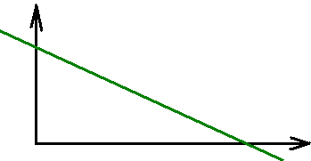
Complementarity Problems
Nonlinear complementarity problem (NCP)
Define:
Find such that:
Linear complementarity problem (LCP)
Given constants and
Find such that:

Slide 12
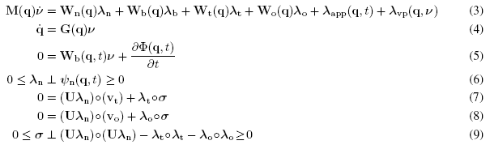
Contact Models are Nasty
Dry (stick-slip) friction is important component of model
Model becomes a differential complementarity problem
Nonlinear and nonsmooth
Velocity
Product
Inertia
Contacts
Joints
Friction
Inputs
Newton-Euler, i.e., f=ma
Velocity Kinematics
Joint Constraints
Non-Penetration
Dry Friction
Notes:
Mathematically nonsmooth.
Not the kind of thing a lot of engineers have experience with
Not the kind of thing that computer scientists have experience with
So most researchers look for work-arounds
Why do we want such a complex model?
Stick-slip friction is needed to model stable grasps.
Model accuracy improves estimation
High-dimensionality prohibits any direct implementation of this model.

Slide 13
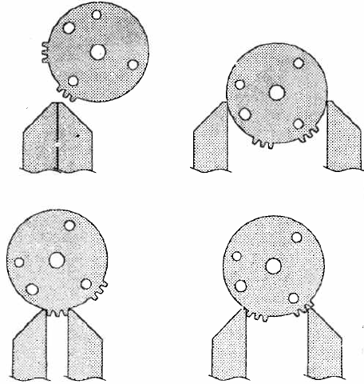
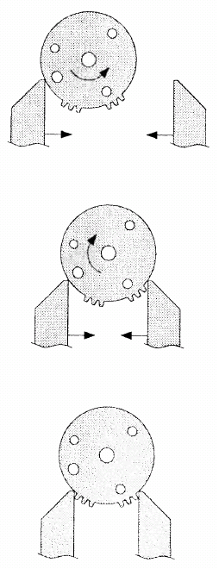
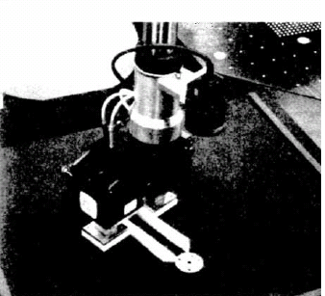
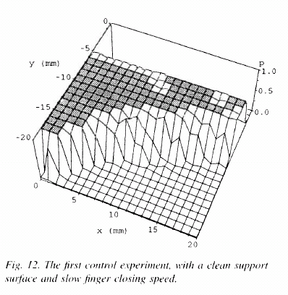
Grasp Acquisition
Parallel jaw gripper grasping lock a lock part
100,800 trials
Several months of technician time
Fast, slow, clean, sand,
Failures
Success Rate
Success
Brost and Christiansen, 1995
Notes:
Success rate versus set-up error

Slide 14
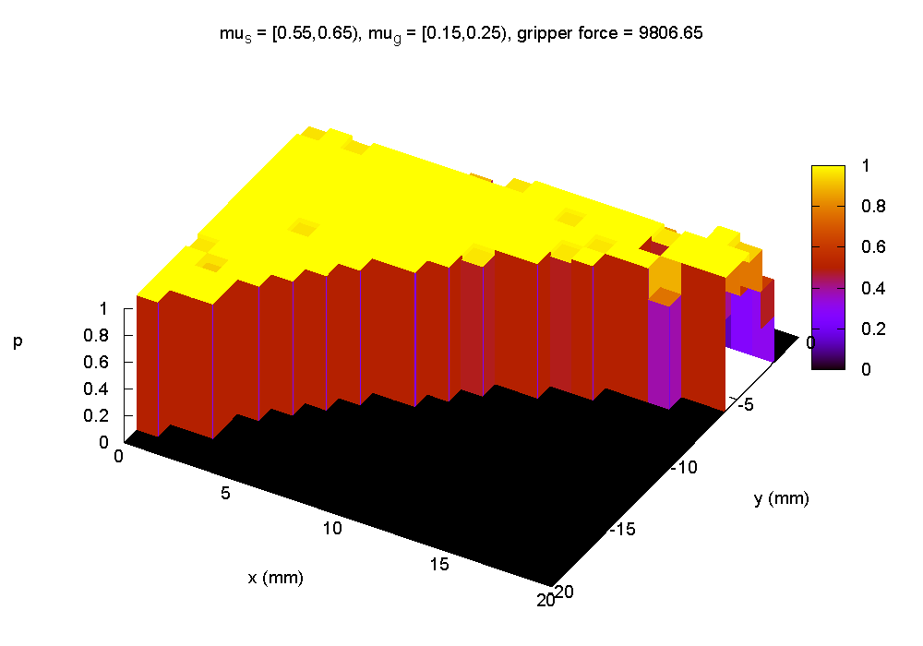
Simulation vs Experiments
Discretize space of initial poses (x, y)
Simulate grasping action until:
Stable grasp
Failed grasp
Success Rate
with Berard
Notes:
We had to experiment with two friction coefficients to make this work
Sloped experimental plot could be due to wear and unmodeled determinism.
We modeled sand on table with time varyng tripods of support.

Slide 15
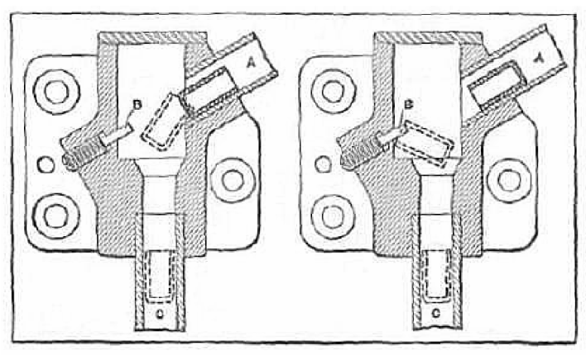
Parts-Feeder Design
Design Goals:
1) Solved without simulation
2) All pegs exit closed end down
2) Maximize through-put??
Boothroyd (cir. 1960)
Notes:
Cannot ignore dynamics.
Intuitive design of Boothroyd in the 1960s.
How do we make this design process computational?

Slide 16
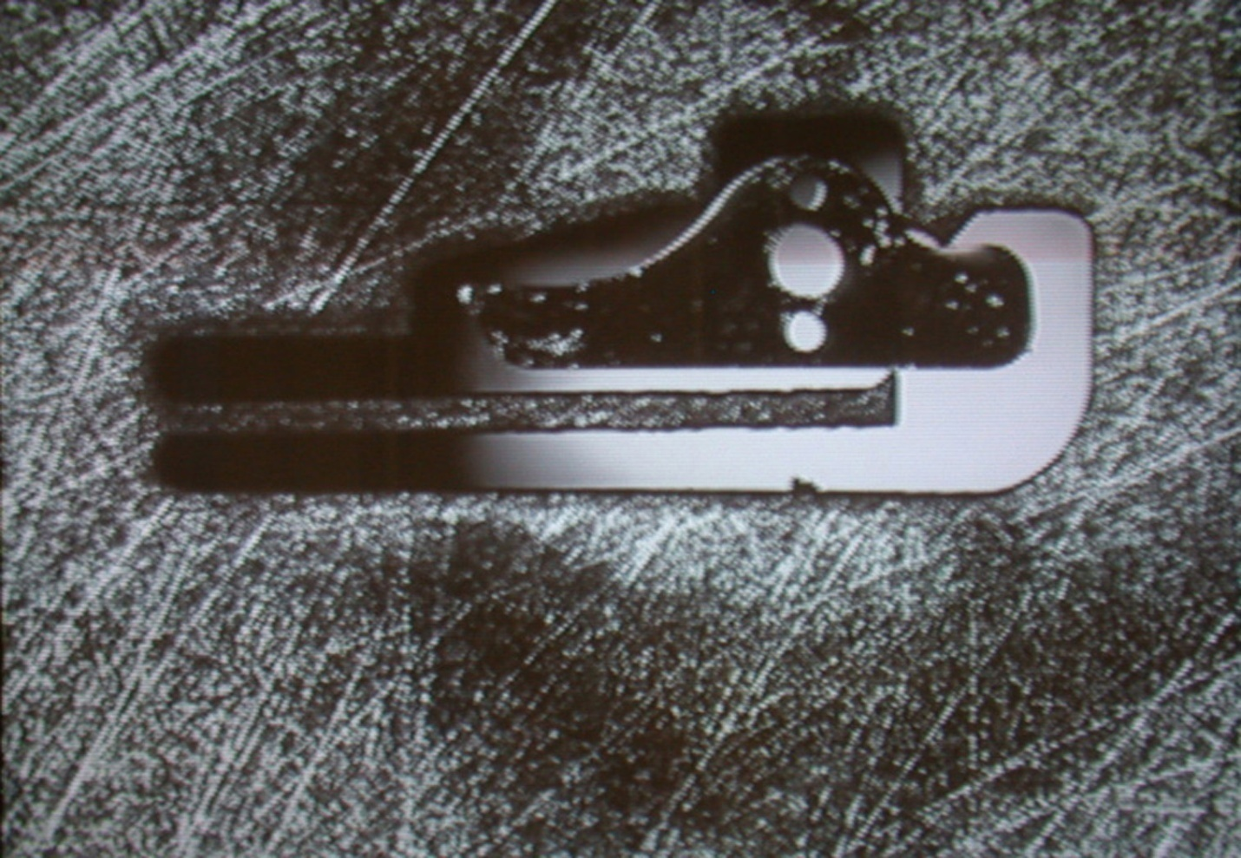
Solving the Pawl Seating Problem
Trial and error coupled with Balkcom, Trinkle IJRR 2002 result.
with Jones and Kozlowsky (Jrnl Mech. 2004)
with Balkcom, Jones, and Kozlowski (
Notes:
Design was found by combination of trial and error, Balkcom/Trinkle analysis, and limited simulation.

Slide 17
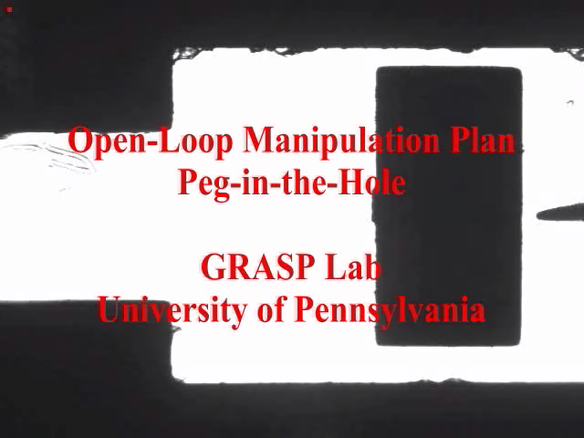
Open-Loop Meso-Scale Insertion
Estimate friction parameters for dVC
Define set of actions for RDT
Execute open-loop
with Cappelleri, et al. 2006

Slide 18
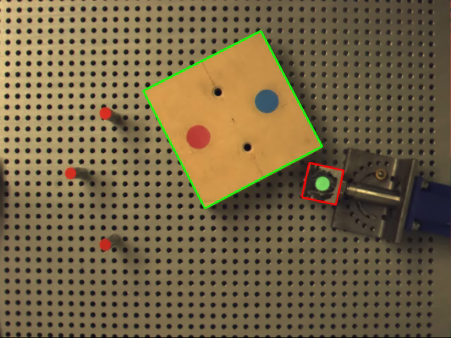
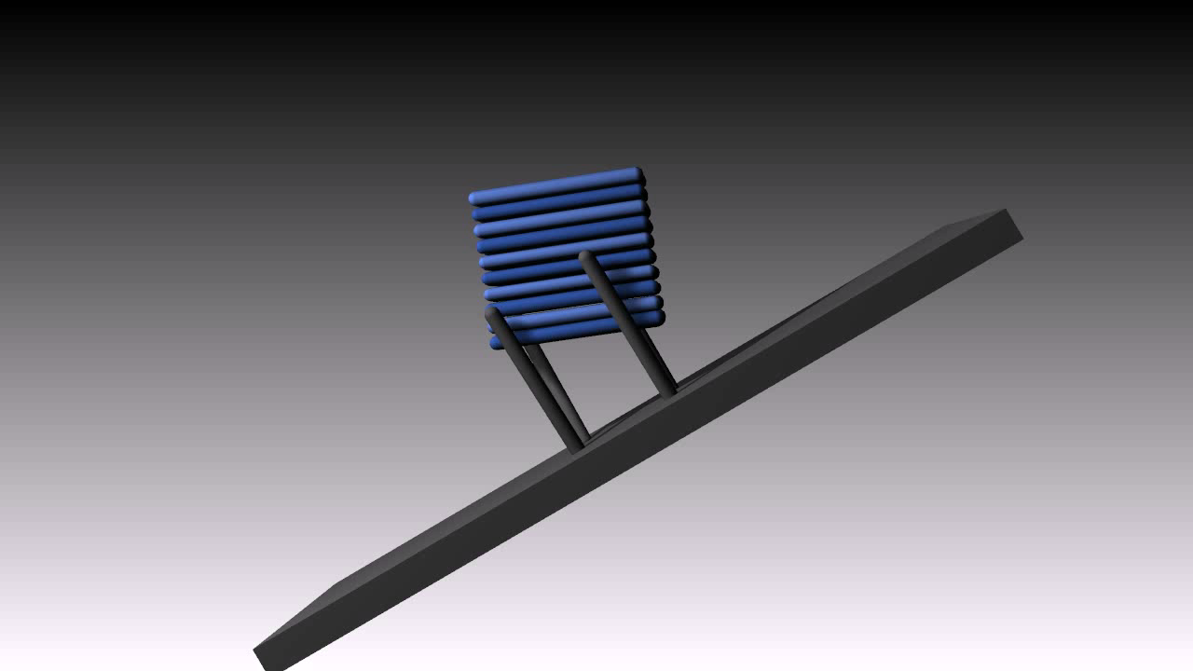
Which Simulator is Best?
Did the solver converge?
Is energy conserved?
Is friction dissipative?
Did simulation match physical system?

Slide 19
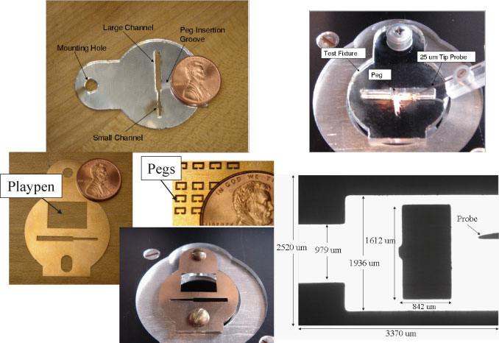
Automated Meso-Scale Assembly
Insertion planned using
Rapidly-exploring Dense Tree (RDT) search
dVC for simulation
Open-loop
execution
with Cappelleri, et al. 2006

Slide 20
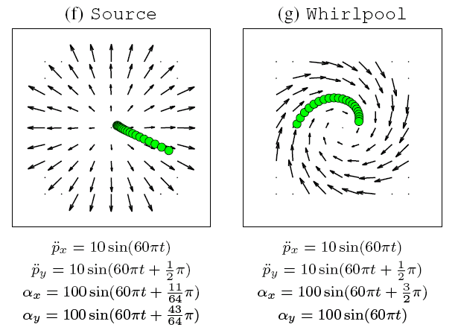
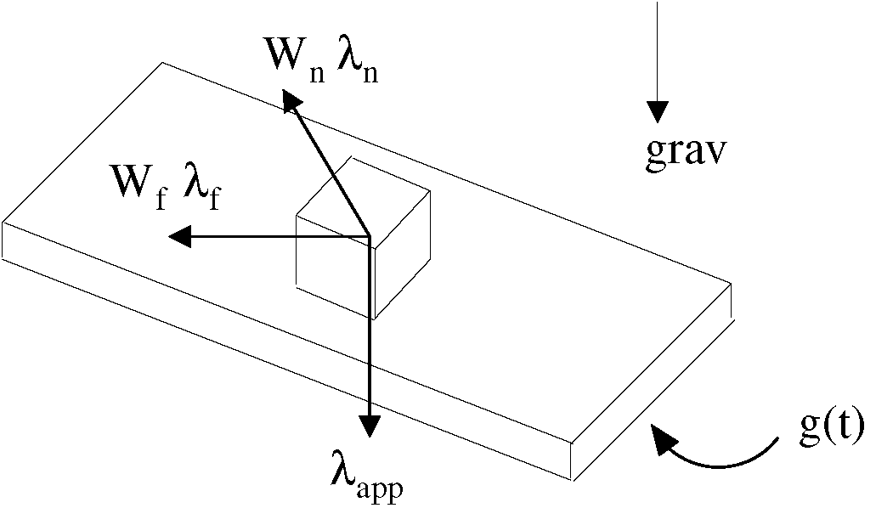
Designing Vibratory Manipulation
Vose, Umbanhower, Lynch assumptions:
Plate moves with 6 dof
Part is a particle
Part maintains contact
Part is always sliding
Single-frequency sinusoidal motions
Notes:
Manipulate small parts in parallel
Control gross motion with “asymptotic velocity fields”
Generated by periodic support surface trajectories that bias the net friction force

Slide 21
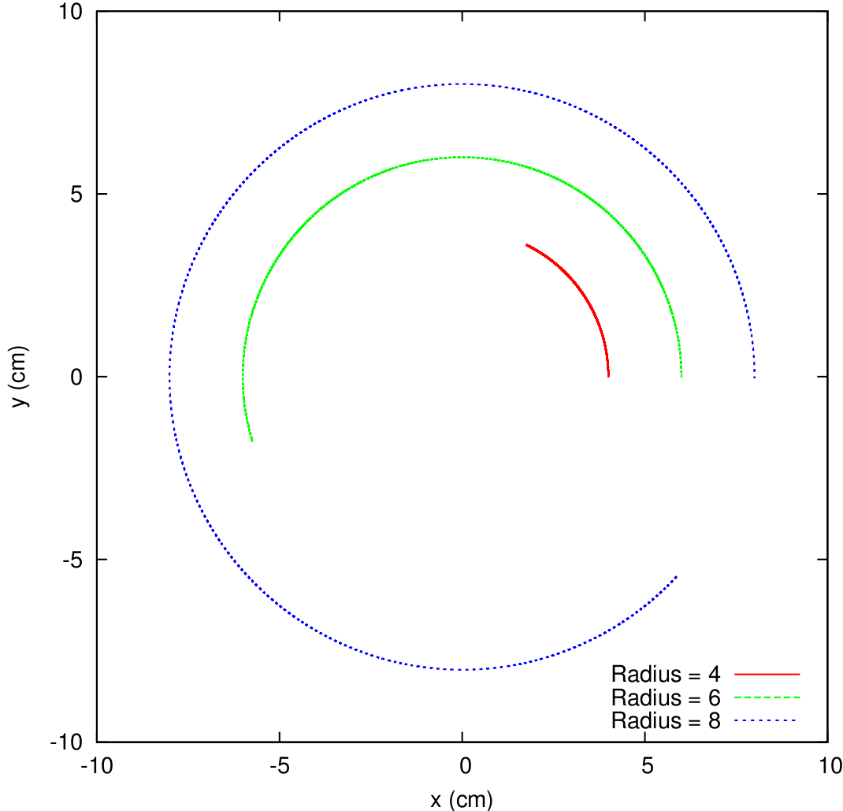
Circle Trajectory Design
Analytically obtained input
Params | Vose+
p1 | 100
p2 | 8
p3 | 4.71

Slide 22
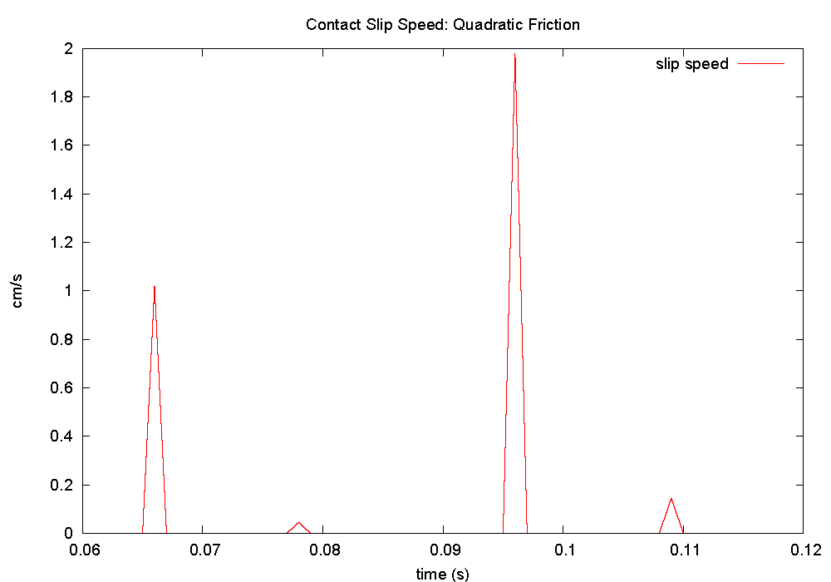
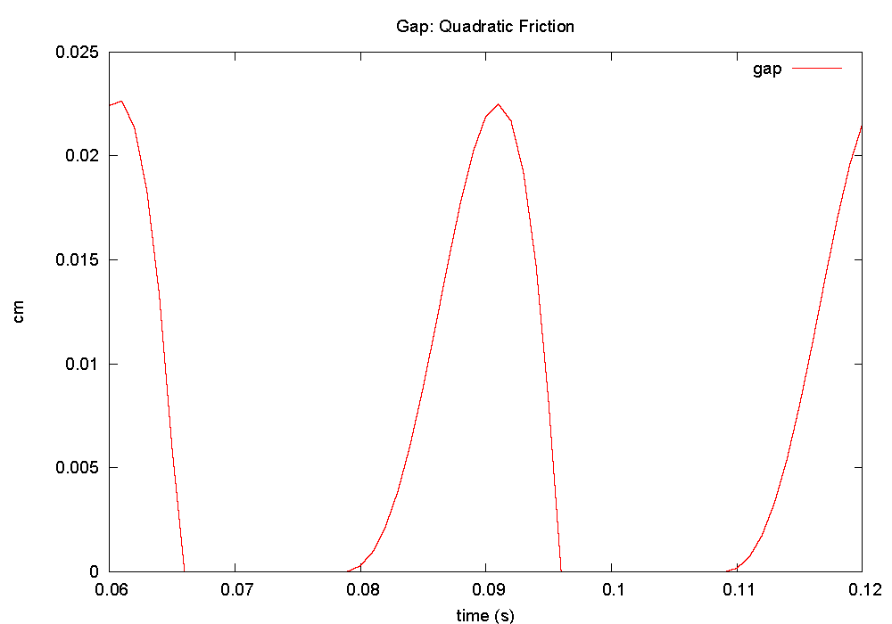
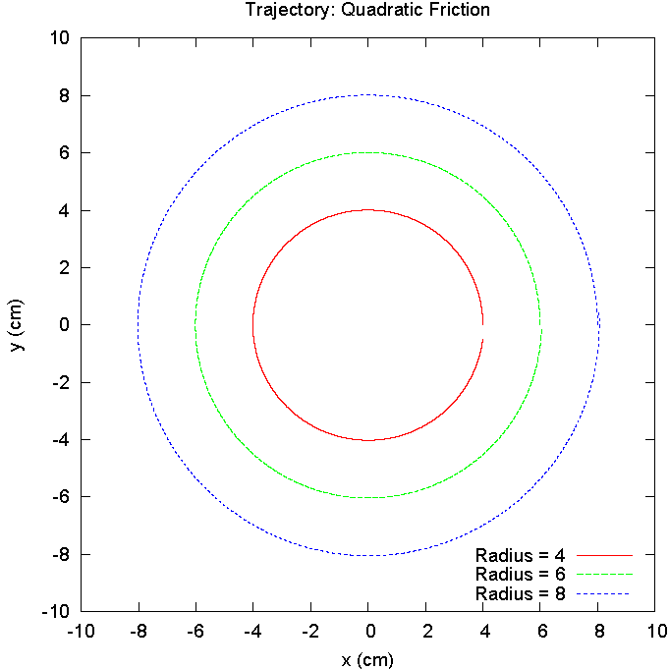
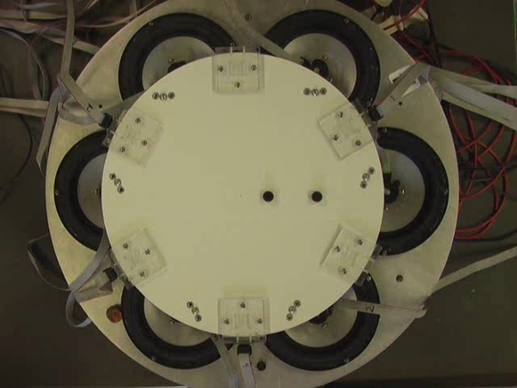
Friction-Induced Velocity Fields
Slip Speed
Distance
Our goals:
Validate simulator
Design beyond theory
MPEC
Params | Vose+ | Berard+
p1 | 100 | 40.78
p2 | 8 | 16.33
p3 | 4.71 | 6.91
Notes:
We were only given friction coefficient

Slide 23
Assembly State Transition Graph
Mating Process
1
1 Contact
2 Contacts
3
1
1,2
2
No Contact
3 Contacts
2
1,3
1,2,3
3
2,3
with Balkcom
Notes:
This is one state transition graph out of many possible.
Because of non-uniqueness, think of this as enabling transitions, but not guaranteeing transitions.
Sets of gext corresponding to each arc can be computed easily for 2D problems.
For each arc, we compute all possible wrenches consistent with that mode.

Slide 24
Jam-Free Assembly: Nonunique Dynamics
Undesirable Transitions
1
1 Contact
2 Contacts
3
1
1,2
2
No Contact
3 Contacts
2
1,3
1,2,3
3
2,3
with Balkcom
Notes:
There are some undesirable transitions that are not shown – 38 total (including those shown)
We don’t have to compute them all, since some can be shown to be subsets of the others
We only compute 12 cones now.

